Slide 1
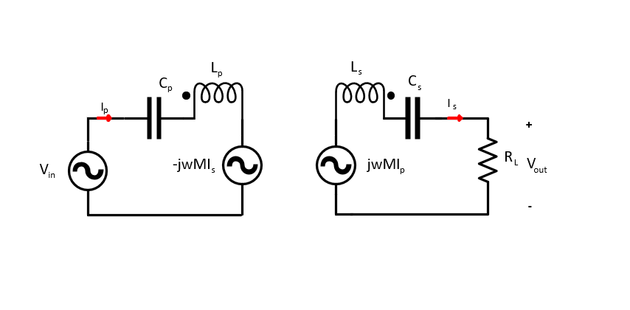
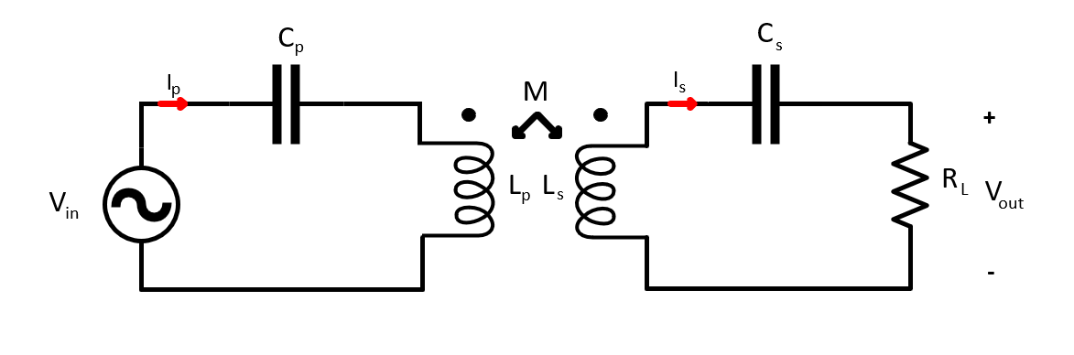
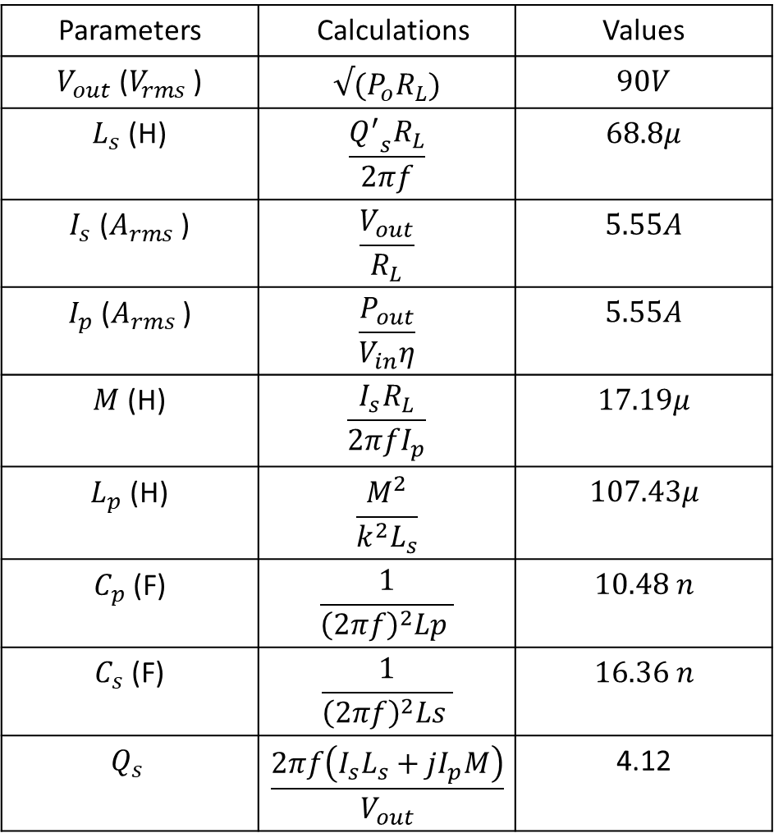
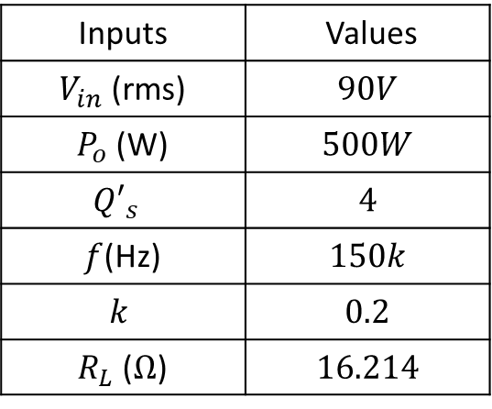
1Tx- 1Rx Design
Parameters | Calculations | Values
$V_{out}$ ($V_{rms}$ ) | $$√(P_{o}R_{L})$$ | $$90V$$
$L_{s}$ (H) | $$\frac{{Q^{′}}_{s}R_{L}}{2πf}$$ | $$68.8μ$$
$I_{s}$ ($A_{rms}$ ) | $$\frac{V_{out}}{R_{L}}$$ | $$5.55A$$
$I_{p}$ ($A_{rms}$ ) | $$\frac{P_{out}}{V_{in}η}$$ | $$5.55A$$
$M$ (H) | $$\frac{I_{s}R_{L}}{2πfI_{p}}$$ | $$17.19μ$$
$L_{p}$ (H) | $$\frac{M^{2}}{k^{2}L_{s}}$$ | $$107.43μ$$
$C_{p}$ (F) | $$\frac{1}{{\left(2πf\right)}^{2}Lp }$$ | $$10.48 n$$
$C_{s}$ (F) | $$\frac{1}{{\left(2πf\right)}^{2}Ls }$$ | $$16.36 n$$
$$Q_{s}$$ | $$\frac{2πf\left(I_{s}L_{s}+jI_{p}M\right)}{V_{out}}$$ | 4.12
Inputs | Values
$V_{in}$ (rms) | $$90V$$
$P_{o}$ (W) | $$500W$$
$${Q′}_{s}$$ | $$4$$
$f$(Hz) | $$150k$$
$$k$$ | $$0.2$$
$R_{L}$ ($Ω$) | $$16.214$$

Slide 2
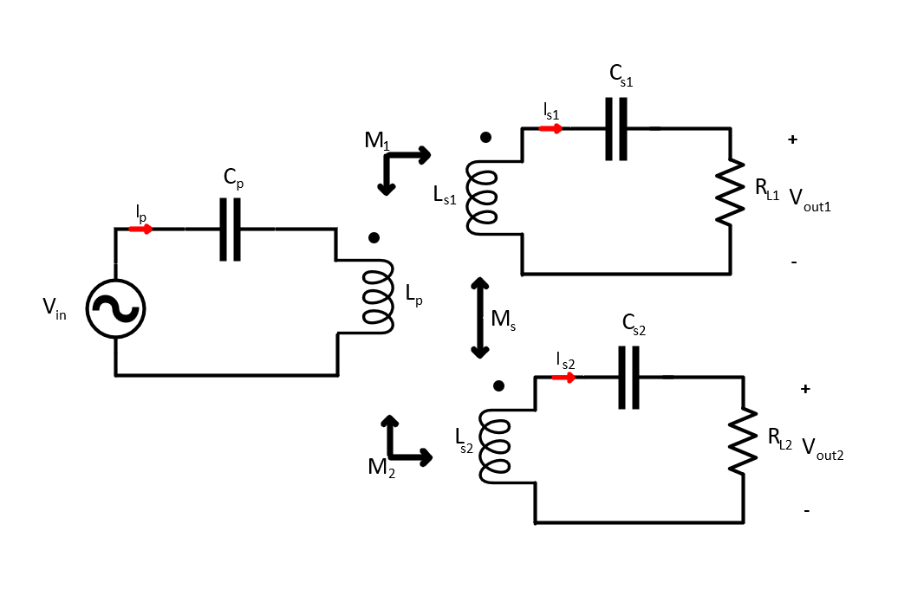
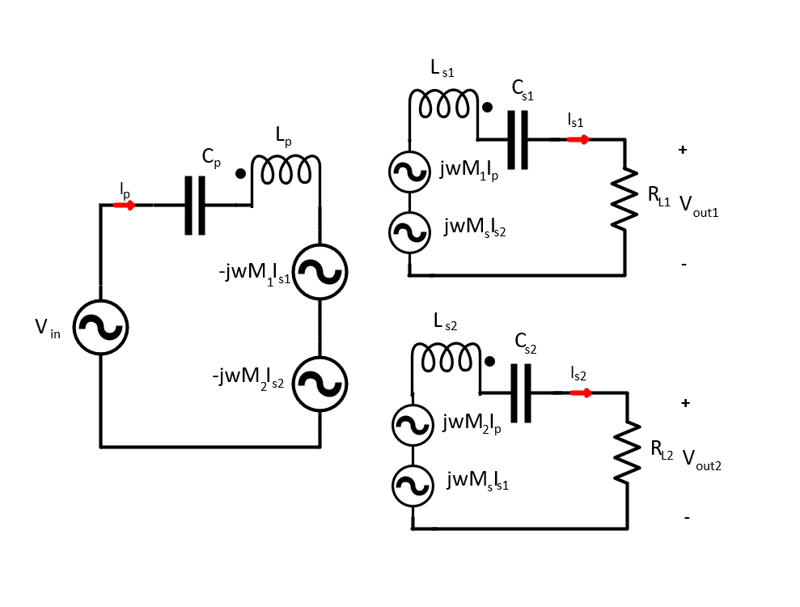
1Tx- 2Rx Design
1Tx-2Rx gives the same power at same output voltage. Then, we change the some of the 1Tx-1Rx parameters and use the other parameters as the same. Thus, we convert the system from 1Tx-1Rx to 1Tx-2Rx by the same analytic calculations.
Assumptions:
Mutual inductances between primary to secondaries are equal.
Mutual inductances between two secondary coils are zero.
Load resistance of the secondary coils are equal.

Slide 3
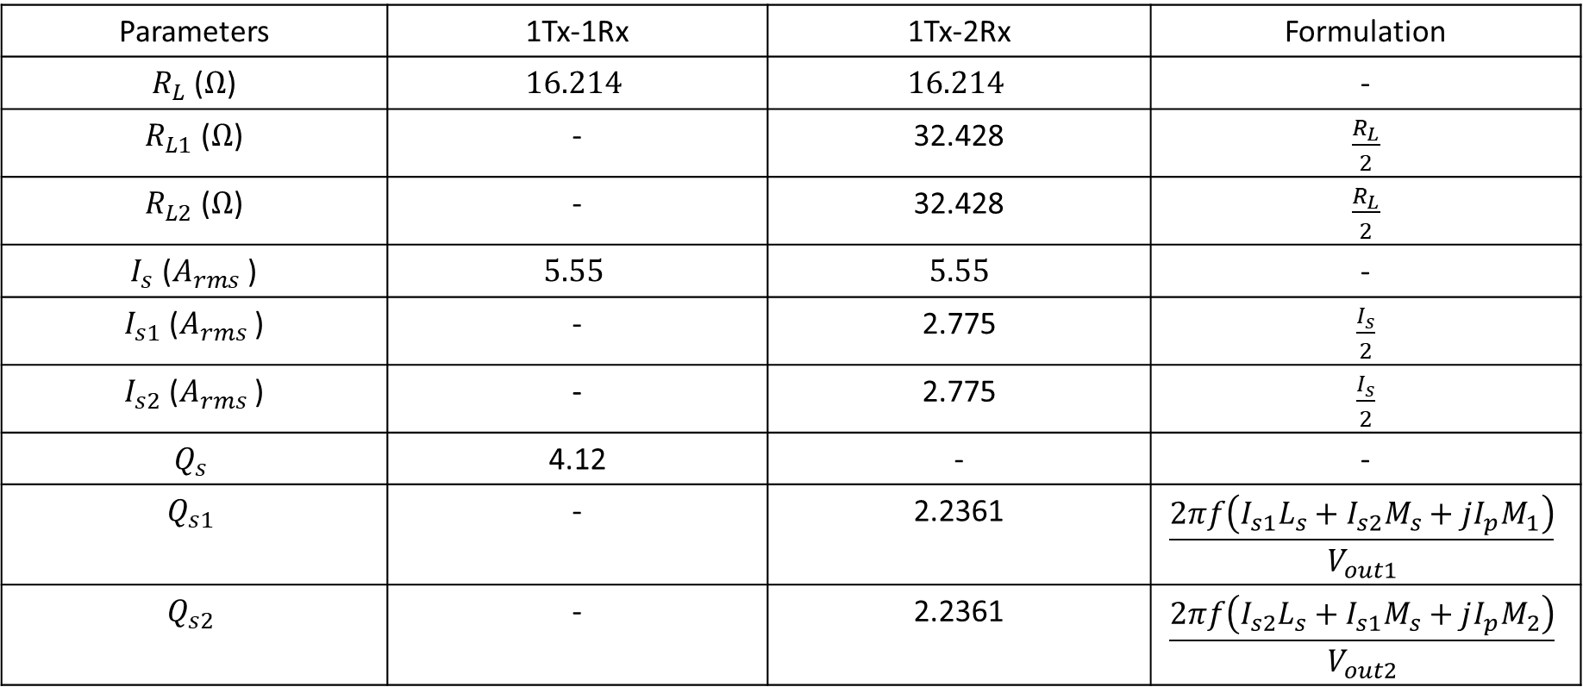
Parameters | 1Tx-1Rx | 1Tx-2Rx | Formulation
$R_{L}$ ($Ω$) | $$16.214$$ | $$16.214$$ | -
$R_{L1}$ ($Ω$) | - | 32.428 | $\frac{R_{L}}{2}$
$R_{L2}$ ($Ω$) | - | 32.428 | $\frac{R_{L}}{2}$
$I_{s}$ ($A_{rms}$ ) | $$5.55$$ | $$5.55$$ | -
$I_{s1}$ ($A_{rms}$ ) | - | 2.775 | $\frac{I_{s}}{2}$
$I_{s2}$ ($A_{rms}$ ) | - | 2.775 | $\frac{I_{s}}{2}$
$$Q_{s}$$ | 4.12 | - | -
$$Q_{s1}$$ | - | 2.2361 | $$\frac{2πf\left(I_{s1}L_{s}+I_{s2}M_{s}+jI_{p}M_{1}\right)}{V_{out1}}$$
$$Q_{s2}$$ | - | 2.2361 | $$\frac{2πf\left(I_{s2}L_{s}+I_{s1}M_{s}+jI_{p}M_{2}\right)}{V_{out2}}$$

Slide 4
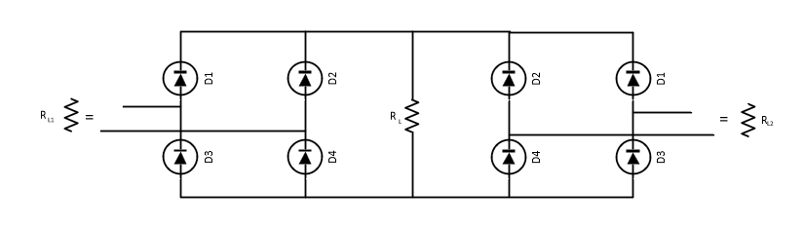
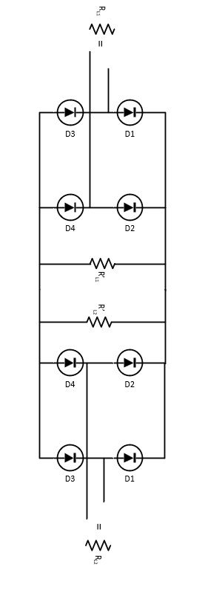
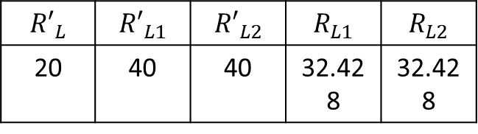
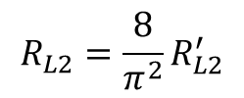

Effect of the rectifier and Equivalent Resistances
In ideal case, each module sees the half of the load. Thus, the current is divided in halves for each module.
${R_{L1}=\frac{8}{π^{2}}R}_{L1}^{′}$
$${R_{L2}=\frac{8}{π^{2}}R}_{L2}^{′}$$
$${R′}_{L}$$ | $${R′}_{L1}$$ | $${R′}_{L2}$$ | $$R_{L1}$$ | $$R_{L2}$$
20 | 40 | 40 | 32.428 | 32.428

Slide 5
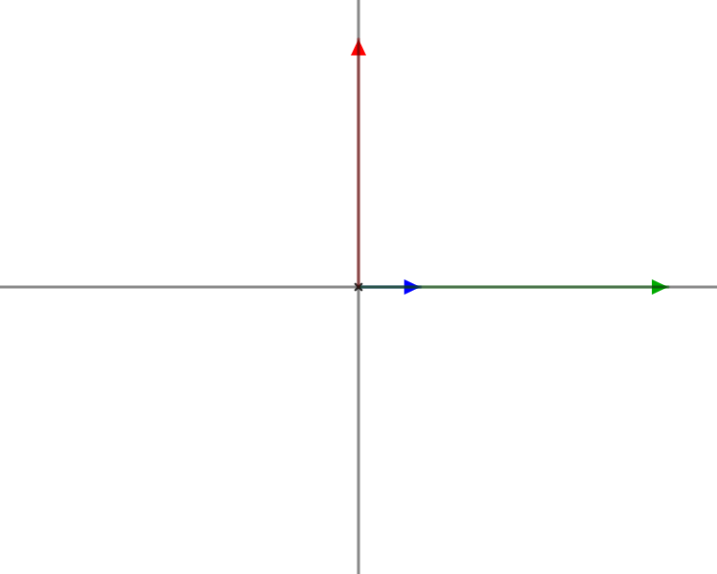
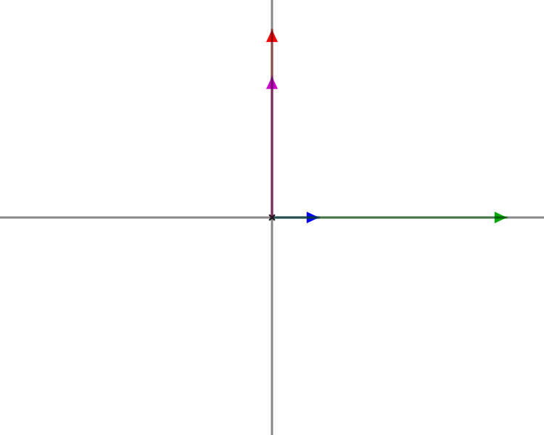









Unequal mutual inductances between primary and secondary coils with decoupled secondary coils
$$wM_{1 }I_{p}$$
$$V_{out}$$
$$wM_{2 }I_{p}$$
$$V_{out}$$
$$wM_{1 }I_{p}$$
Output voltages are changes
$$wM_{2 }I_{p}$$
$$I_{p}$$
$$V_{in}$$
$$V_{in}$$
Source File
Source File
Equal mutual inductance
Inequal mutual inductance

Slide 6
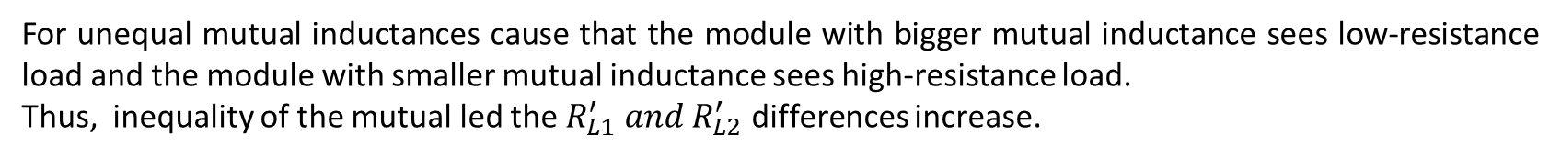
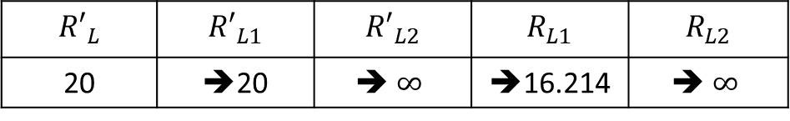
For unequal mutual inductances cause that the module with bigger mutual inductance sees low-resistance load and the module with smaller mutual inductance sees high-resistance load.
Thus, inequality of the mutual led the $R_{L1}^{′} and R_{L2}^{′}$ differences increase.
$${R′}_{L}$$ | $${R′}_{L1}$$ | $${R′}_{L2}$$ | $$R_{L1}$$ | $$R_{L2}$$
20 | ➔20 | ➔ $∞$ | ➔16.214 | ➔ $∞$
Thus , the power is transferred by one seconder module. One of the seconder current is doubled.
Also, the seconder side has higher quality factor. (The Quality factor increases 2.23 to 4.13)
For primary side, there is no differences. It sees the same reflected impedance.

Slide 7
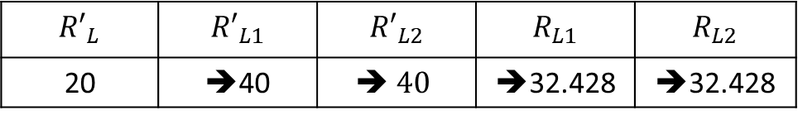
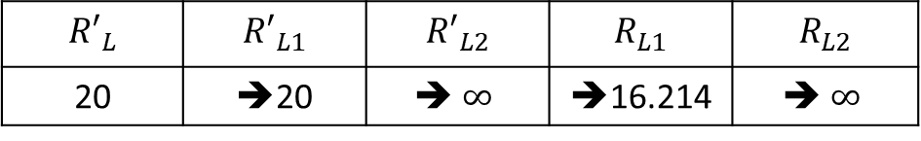
Unequal mutual inductances between primary and secondary coils with coupled secondary coils
$${R′}_{L}$$ | $${R′}_{L1}$$ | $${R′}_{L2}$$ | $$R_{L1}$$ | $$R_{L2}$$
20 | ➔20 | ➔ $∞$ | ➔16.214 | ➔ $∞$
$${R′}_{L}$$ | $${R′}_{L1}$$ | $${R′}_{L2}$$ | $$R_{L1}$$ | $$R_{L2}$$
20 | ➔40 | ➔ $40$ | ➔32.428 | ➔32.428
The aim is that balancing seconder currents , equivalent load resistances.
It is possible by giving a negative coupling between seconder coils.
However, the seconder coupling changes the resonance frequency and quality factor. They should be analyzed.

Slide 8
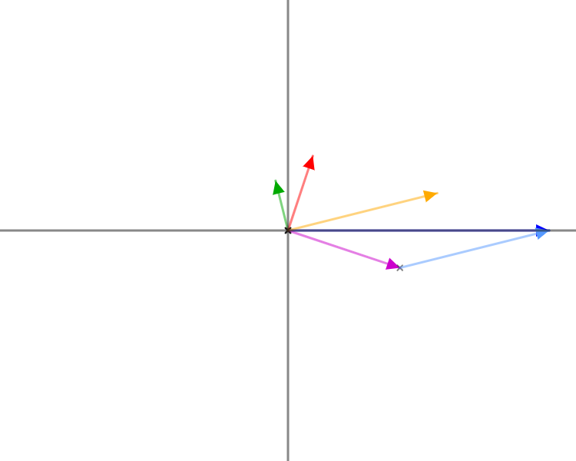
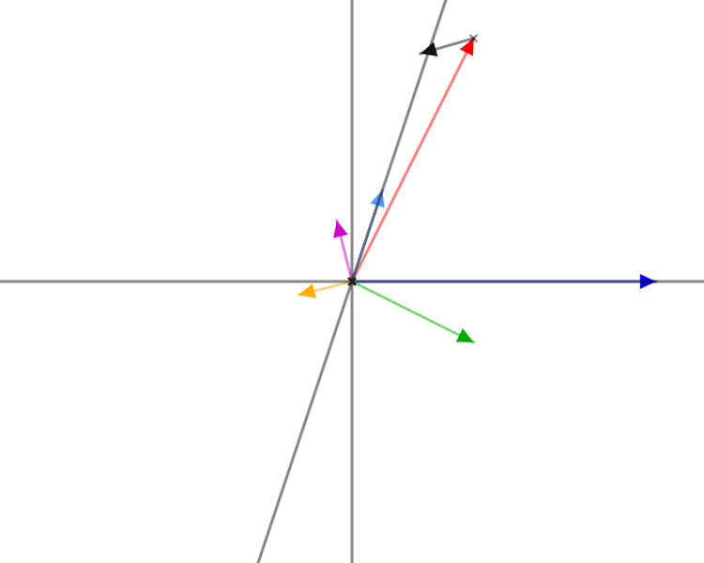
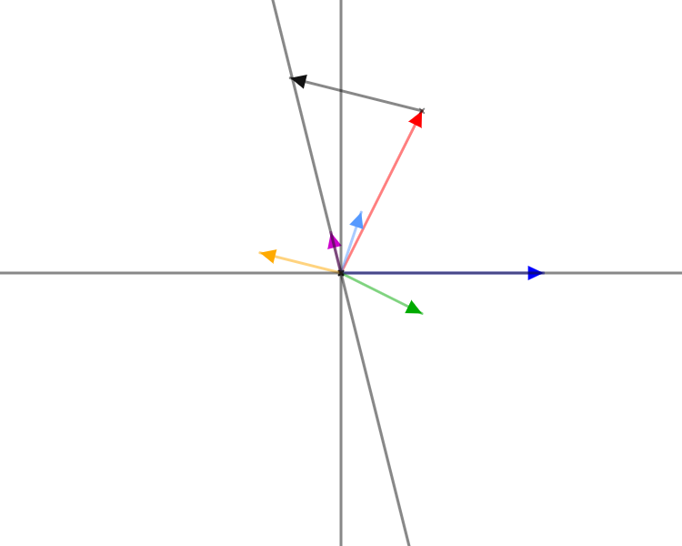


















Phasor Voltage and Current Representation of the 1Tx-2Rx WPT
$$V_{out}$$
$$wM_{s }I_{s2}$$
$$wM_{1 }I_{p}$$
$$V_{out}$$
$$wM_{2 }I_{p}$$
$$I_{s1}$$
$$wM_{s }I_{s1}$$
$$I_{s2}$$
$$wM_{2 }I_{p}$$
$$I_{s1}$$
$$V_{in}$$
$$I_{s2}$$
$$V_{in}$$
$$I_{s1}$$
$$V_{in}$$
$$I_{s2}$$
$$wM_{s }I_{s1}$$
$$wM_{2 }I_{p}$$
$$wM_{s }I_{s2}$$
$$I_{p}$$
$$wM_{1 }I_{p}$$
$$I_{p}$$
Source Code
Source Code
Source Code

Slide 9
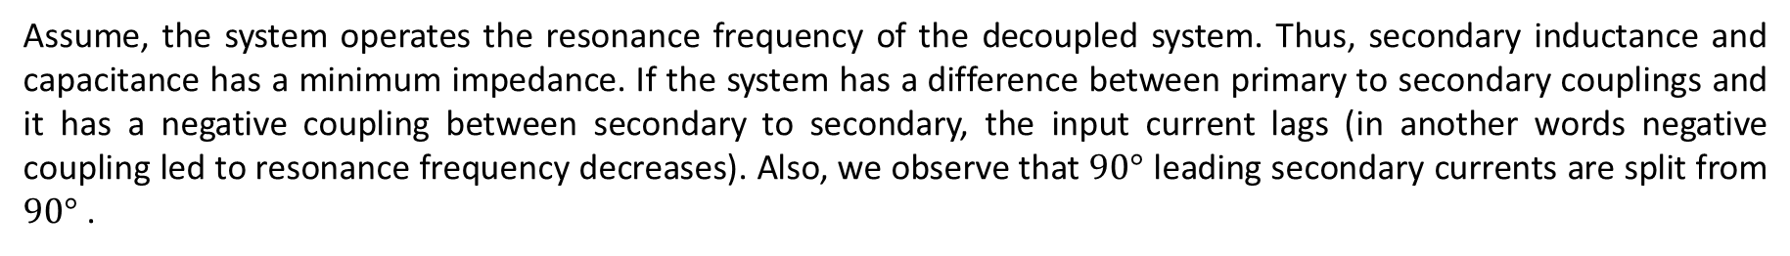
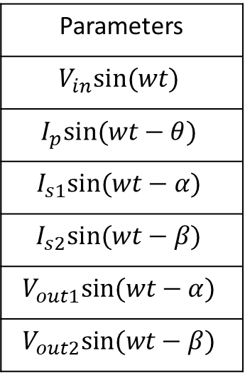
Assume, the system operates the resonance frequency of the decoupled system. Thus, secondary inductance and capacitance has a minimum impedance. If the system has a difference between primary to secondary couplings and it has a negative coupling between secondary to secondary, the input current lags (in another words negative coupling led to resonance frequency decreases). Also, we observe that $90°$ leading secondary currents are split from $90°$ .
Also, we have three equations for a primary and two secondary coils.
Parameters
$$V_{in}sin⁡(wt)$$
$$I_{p}sin⁡(wt−θ)$$
$$I_{s1}sin⁡(wt−α)$$
$$I_{s2}sin⁡(wt−β)$$
$$V_{out1}sin⁡(wt−α)$$
$$V_{out2}sin⁡(wt−β)$$
$$V_{in}\sin\left(wt\right)=−(wM_{1}I_{s1}\cos\left(wt−α\right)+wM_{2}I_{s2}cos⁡(wt−β))$$
$$wM_{1}I_{p}\cos\left(wt−θ\right)+wM_{s}I_{s2}\cos\left(wt−β\right)=V_{out}sin⁡(w_{t}−α)$$
$$wM_{2}I_{p}\cos\left(wt−θ\right)+wM_{s}I_{s1}\cos\left(wt−α\right)=V_{out}sin⁡(w_{t}−β)$$

Slide 10
We can apply the conversion of sine and obtain six equation
$$V_{in}\sin\left(wt\right)=−wM_{1}I_{s1}\left(\cos\left(α\right)\cos\left(wt\right)+\sin\left(α\right)\sin\left(wt\right)\right)−wM_{2}I_{s2}(\cos\left(β\right)\cos\left(wt\right)+\sin\left(β\right)sin⁡(wt))$$
$$wM_{1}I_{p}(\cos\left(θ\right)\cos\left(wt\right)+\sin\left(θ\right)sin⁡(wt))+wM_{s}I_{s2}(\cos\left(β\right)\cos\left(wt\right)+\sin\left(β\right)sin⁡(wt))=V_{out}(cos\left(α\right)\sin\left(wt\right)−\sin\left(α\right)cos⁡(wt))$$
$$wM_{2}I_{p}(\cos\left(θ\right)\cos\left(wt\right)+\sin\left(θ\right)sin⁡(wt))+wM_{s}I_{s1}(\cos\left(α\right)\cos\left(wt\right)+\sin\left(α\right)sin⁡(wt))=V_{out}(cos\left(β\right)\sin\left(wt\right)−\sin\left(β\right)cos⁡(wt))$$
$$V_{in}\sin\left(wt\right)=−wM_{1}I_{s1}\sin\left(α\right)\sin\left(wt\right)−wM_{2}I_{s2}\sin\left(β\right)sin⁡(wt)$$
Primer
$$0=−wM_{1}I_{s1}\cos\left(α\right)\cos\left(wt\right)−wM_{2}I_{s2}\cos\left(β\right)\cos\left(wt\right)$$
$$wM_{1}I_{p}cos⁡(θ)\cos\left(wt\right)+wM_{s}I_{s2}\cos\left(β\right)\cos\left(wt\right)=−V_{out}\sin\left(α\right)cos⁡(wt)$$
Seconder 1
$$wM_{1}I_{p}\sin\left(θ\right)\sin\left(wt\right)+wM_{s}I_{s2}\sin\left(β\right)sin⁡(wt)=V_{out}cos\left(α\right)\sin\left(wt\right)$$
$$wM_{2}I_{p}cos⁡(θ)\cos\left(wt\right)+wM_{s}I_{s1}\cos\left(α\right)\cos\left(wt\right)={−V}_{out}\sin\left(β\right)cos⁡(wt)$$
Seconder 2
$wM_{2}I_{p}\sin\left(θ\right)\sin\left(wt\right)+wM_{s}I_{s1}\sin\left(α\right)sin⁡(wt)=V_{out}cos\left(β\right)$ $sin⁡(wt)$

Slide 11
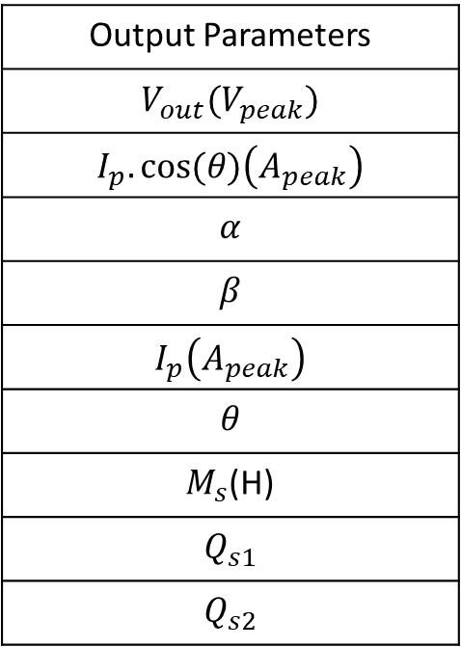
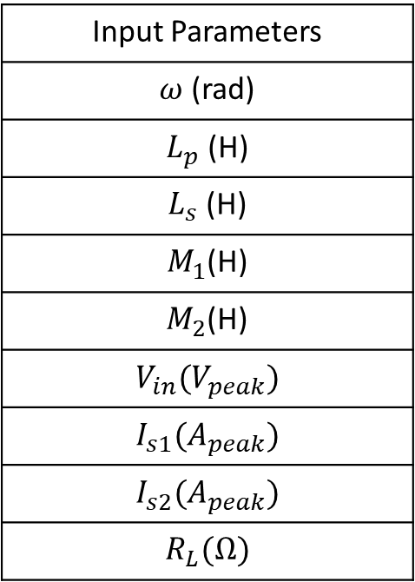
Input Parameters
$ω$ (rad)
$L_{p}$ (H)
$L_{s}$ (H)
$M_{1}$(H)
$M_{2}$(H)
$V_{in}(V_{peak})$
$I_{s1}(A_{peak})$
$I_{s2}(A_{peak})$
$R_{L}(Ω)$
Output Parameters
$V_{out}(V_{peak})$
$I_{p}.cos⁡(θ)\left(A_{peak}\right)$
$α$
$β$
$I_{p}\left(A_{peak}\right)$
$$θ$$
$M_{s}$(H)
$$Q_{s1}$$
$$Q_{s2}$$
1Tx-1Rx design results are used as input parameters and we find the required mutual inductance between the secondary coils to avoid inequality of the current. Also, we find Quality factors for the mutual inductance.

Slide 12



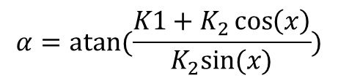


Step 1- Calculation of output voltage and real part of the input current
$$V_{out}=\left(I_{s1}+I_{s2}\right)R_{L}$$
${I_{pf}= I}_{p}.\cos\left(θ\right)=\frac{V_{out}\left(I_{s1}+I_{s2}\right)}{V_{in}}$
Step 2- Calculation of phases of the output currents
$$K_{1}=ωM_{1}I_{s1}$$
$$x=180−acos⁡((V_{in}^{2}−K_{1}^{2}−K_{2}^{2})/(−2K_{1}K_{2}))$$
$$K_{2}=ωM_{2}I_{s2}$$
$$α=atan⁡(\frac{K1+K_{2}\cos\left(x\right)}{K_{2}sin⁡(x)})$$
$$β=α+x$$

Slide 13


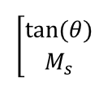










Step 3- Calculation of mutual inductance between secondary coils and phase of input currents (by using second secondary coil)
$$A_{1}=ωM_{2}I_{pf}$$
$$A_{2}=0$$
$$A_{3}=ωI_{s1}cos⁡(90+α)$$
$$A_{4}=ωI_{s1}sind(90+alpha )$$
$B_{1}=V_{out}sin⁡(β)$
$$B_{2}=V_{out}\sin\left(β\right)−ωM_{2}Ip_{f}$$
A =
$$\left[\begin{matrix}A_{1} & A_{3} \\ A_{2} & A_{4}\end{matrix}\right]$$
B =
x=
$$x=A^{−1}B$$
$$M_{s}=x(2)$$
$$θ=atan⁡(x\left(1\right))$$
The formulation can be applied to first seconder coils to find $M_{s}$ and $θ$

Slide 14
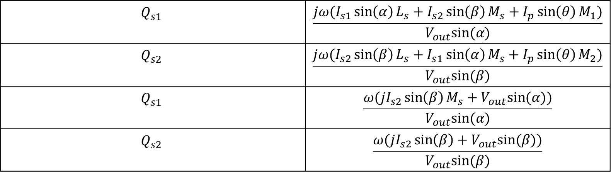
Step 4- Quality factors of the secondary coils for calculated $M_{s}$
$$Q_{s1}$$ | $$\frac{jω(I_{s1}\sin\left(α\right)L_{s}+I_{s2}\sin\left(β\right)M_{s}+I_{p}\sin\left(θ\right)M_{1})}{V_{out}sin⁡(α)}$$
$$Q_{s2}$$ | $$\frac{jω(I_{s2}\sin\left(β\right)L_{s}+I_{s1}\sin\left(α\right)M_{s}+I_{p}\sin\left(θ\right)M_{2})}{V_{out}sin⁡(β)}$$
$$Q_{s1}$$ | $$\frac{ω({jI}_{s2}\sin\left(β\right)M_{s}+V_{out}sin⁡(α))}{V_{out}sin⁡(α)}$$
$$Q_{s2}$$ | $$\frac{ω({jI}_{s2}\sin\left(β\right)+V_{out}sin⁡(β))}{V_{out}sin⁡(β)}$$

Slide 15
Future Work
Effect of secondary coupling to resonance frequency .(We got a smaller resonance frequency )
Effect of Series and Parallel modules with a common bus (We observe that series connection gives a redundant secondary coils for inequal mutual inductance with decoupled secondary coils)

